Slide 1
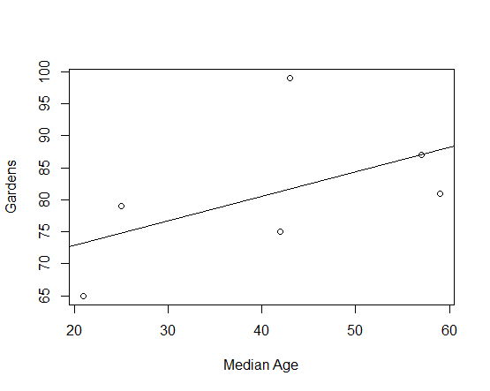
Week 11:Univariate regression
Geog4300: Shannon

Slide 2
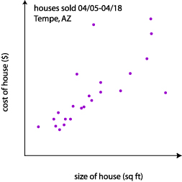
Correlation
tells us how strongly x and y are related
Regression
tells us how a change in x is associated with a change in y
Correlation:
There is a strong positive relationship (r=0.81) between the size of a house and its selling price.
Regression:
The price of a house goes up $10,000 for each additional 500 square feet.
Notes:
Alternative hypothesis is usually what you’re trying to prove.

Slide 3
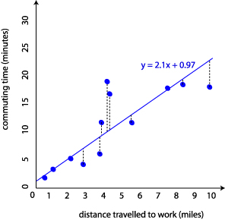

Some terminology
Regression coefficient (or beta)
Error term
R²
Residual
$$y=βx+ ε$$
R² = 0.65
Notes:
Alternative hypothesis is usually what you’re trying to prove.

Slide 4
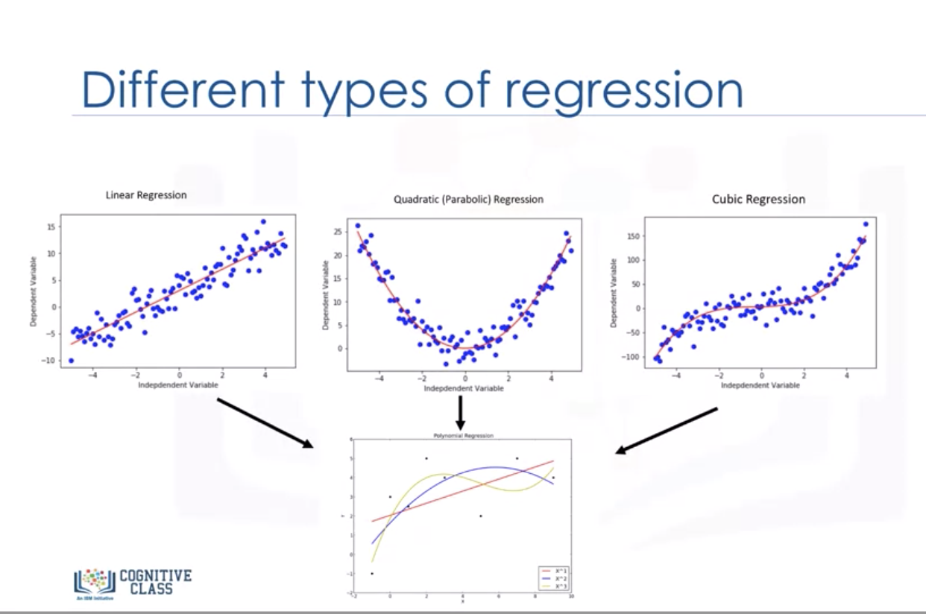
Not all regression uses a linear form
Notes:
Alternative hypothesis is usually what you’re trying to prove.

Slide 5
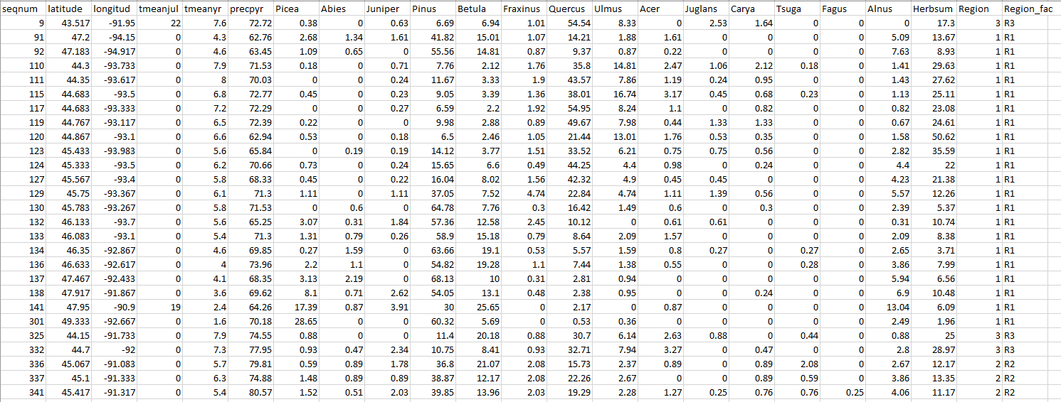
Regression in Excel
Notes:
Alternative hypothesis is usually what you’re trying to prove.

Slide 6
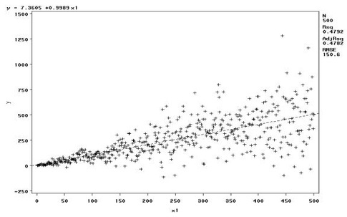
Diagnostics
Are your residuals normal?
Heteroskedasticity?
What about outliers?
Notes:
Alternative hypothesis is usually what you’re trying to prove.

Slide 7
Calculating residuals and testing normality in Excel
Notes:
Alternative hypothesis is usually what you’re trying to prove.

Slide 8
You try it!
Create a regression model using temperature or precipitation as the independent variable and pollen counts for one tree species as the dependent variable.
Write a summary of the results, focusing on the coefficients’ strength, magnitude, and significance as well as the overall model fit using the R².
Notes:
Alternative hypothesis is usually what you’re trying to prove.

Slide 9
What tests have we covered?
T-tests: One-sample, Two-sample, Paired, non-parametric
Chi-square
ANOVA
Correlation
Regression
In pairs or on your own: Come up with a research question that can be answered by one of these tests.
Notes:
Alternative hypothesis is usually what you’re trying to prove.

Slide 10
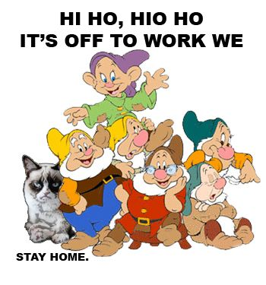
Work time: Lab 5
Notes:
Alternative hypothesis is usually what you’re trying to prove.

